Slide 1
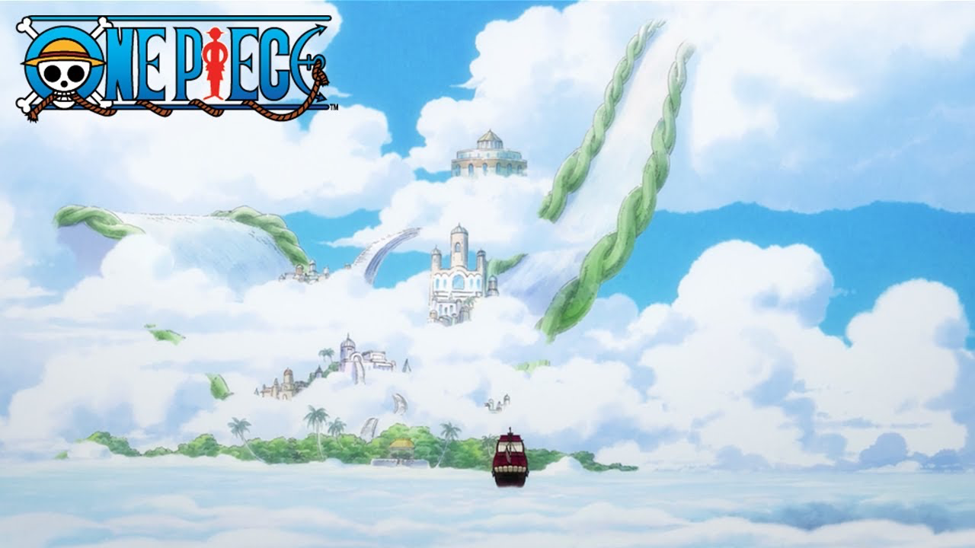
Notes:
Skypiea / One Piece

Slide 2
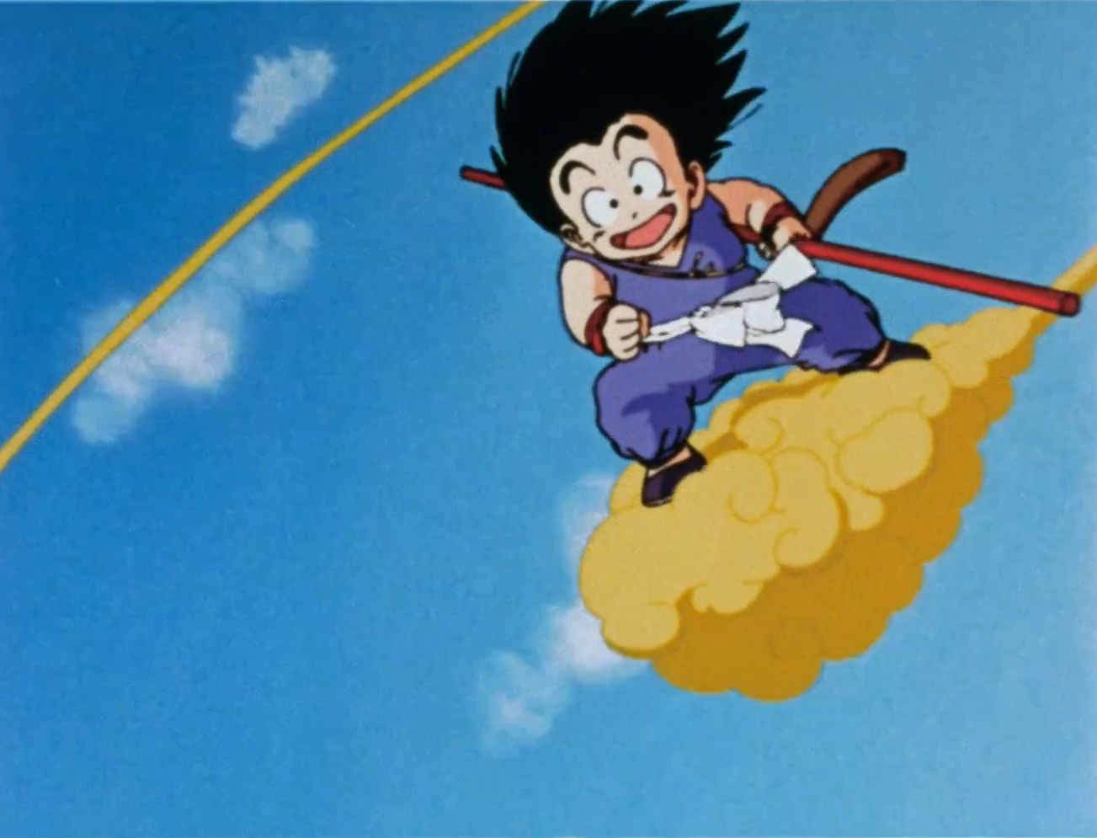
Notes:
Flying nimbus

Slide 3
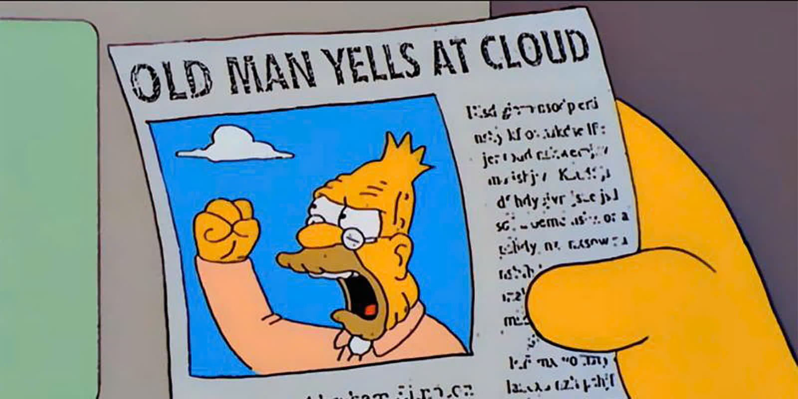
Notes:
Old man yells at cloud

Slide 4

Notes:
Partly Cloudy

Slide 5

Notes:
AWS

Slide 6
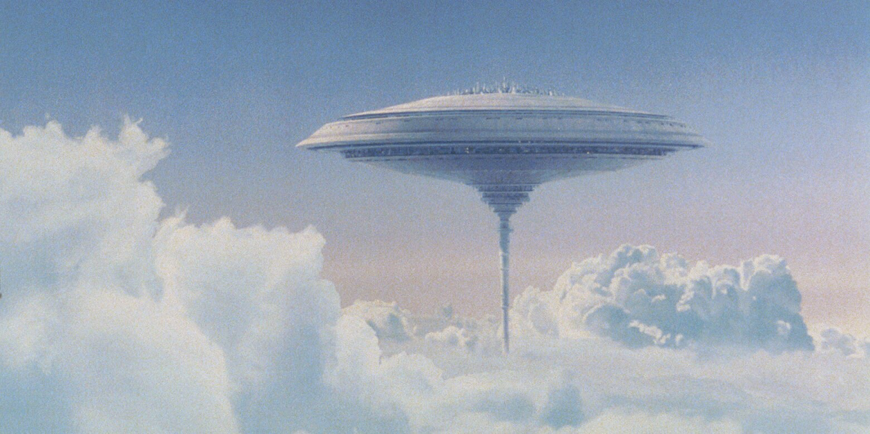
Notes:
Cloud City

Slide 7

Notes:
xcloud

Slide 8

Notes:
cloudflare

Slide 9
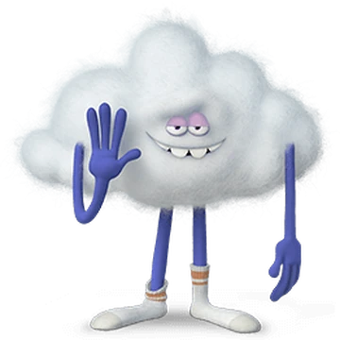
Notes:
Cloud guy

Slide 10
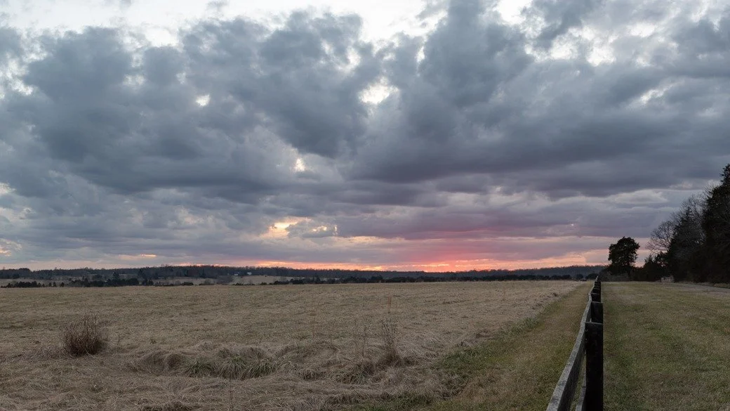
Notes:
Stratocumulus clouds

Slide 11

Notes:
salesforce

Slide 12
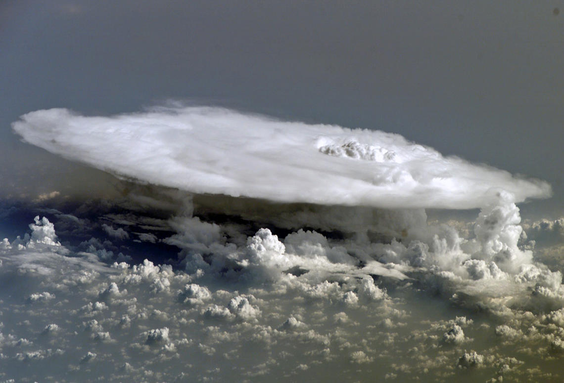
Notes:
Cumulonimbus clouds

Slide 13
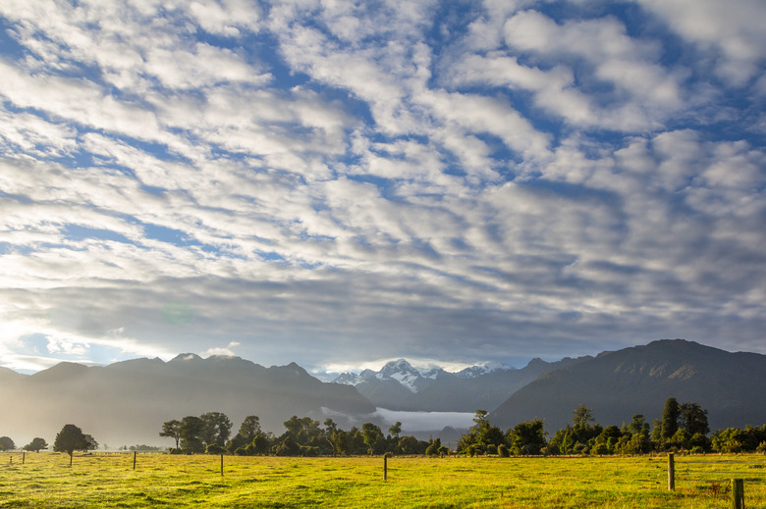
Notes:
Stratus clouds

Slide 14

Notes:
Drifloon

Slide 15
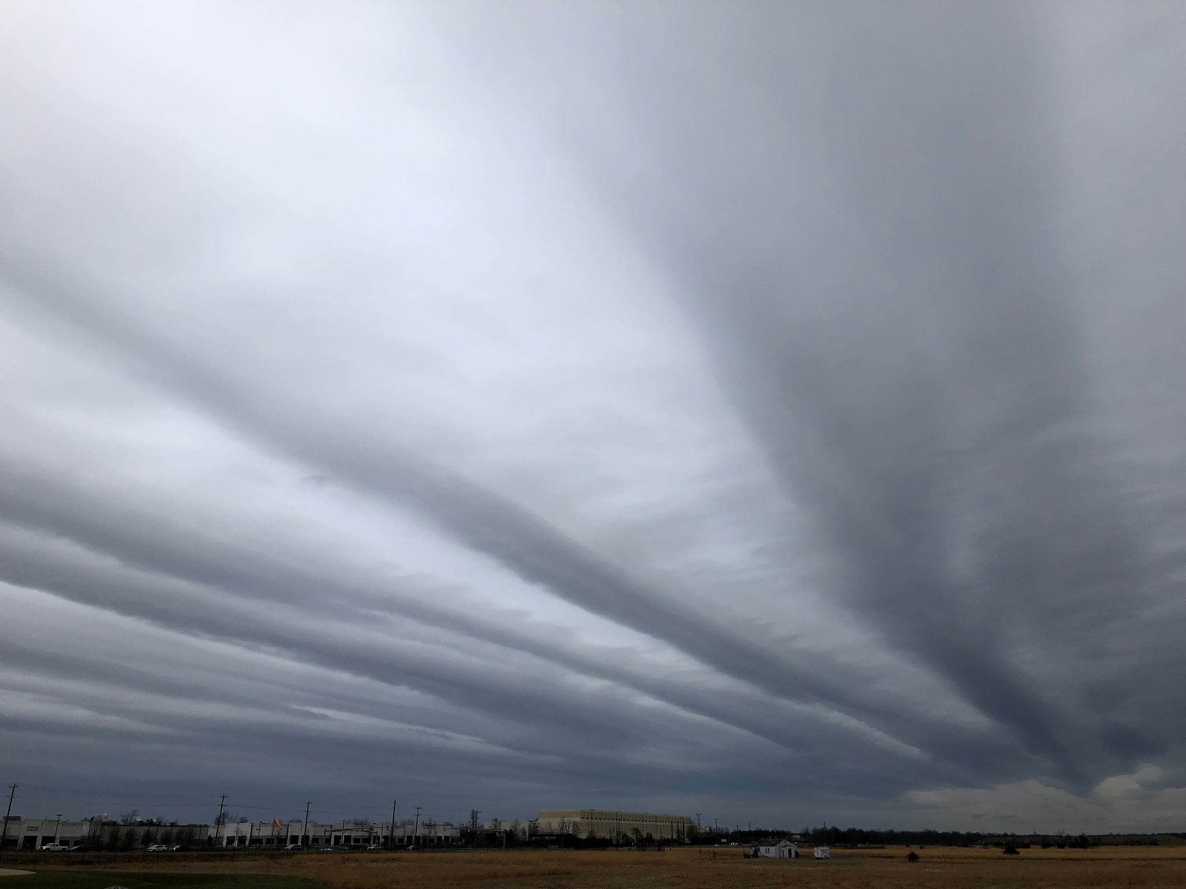
Notes:
Altostratus

Slide 16

Notes:
soundcloud

Slide 17
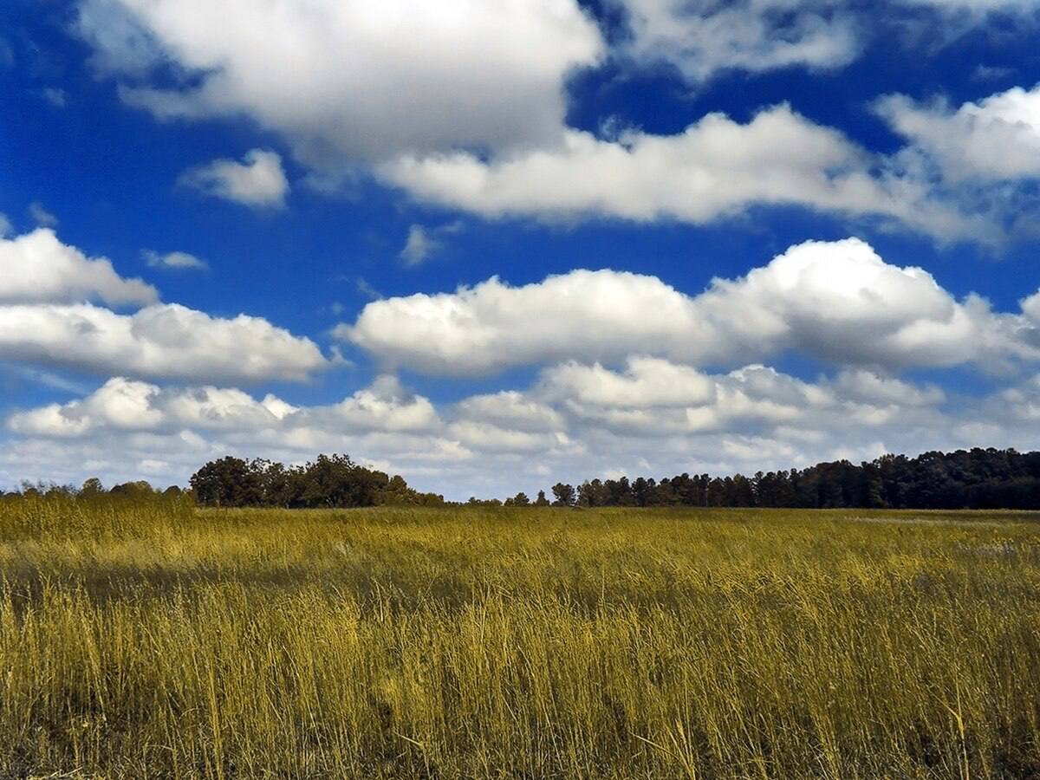
Notes:
Cumulus clouds

Slide 18

Notes:
Lakitu

Slide 19

Notes:
icloud

Slide 20
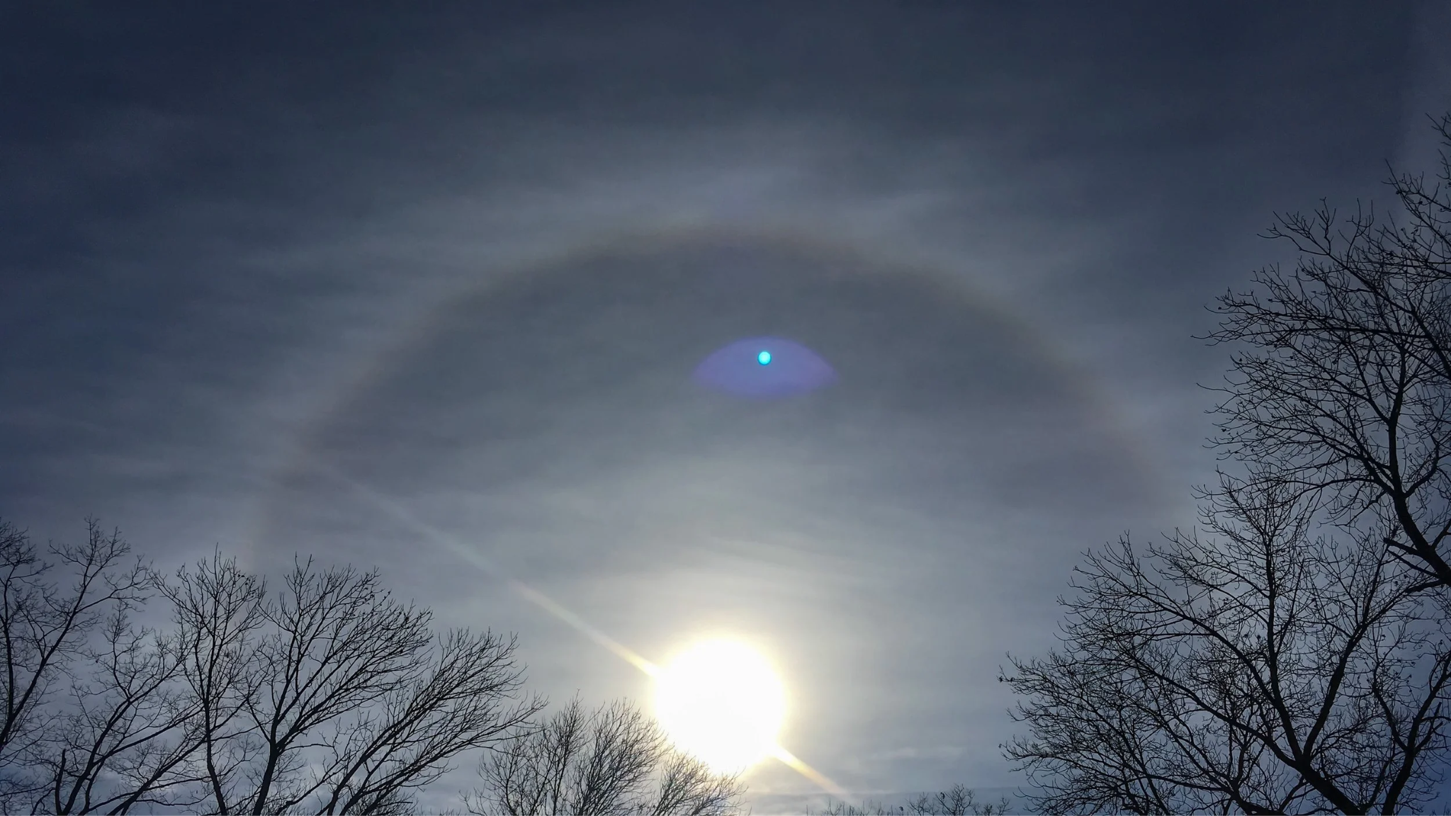
Notes:
Cirrostratus clouds

Slide 21

Notes:
Toy Story

Slide 22
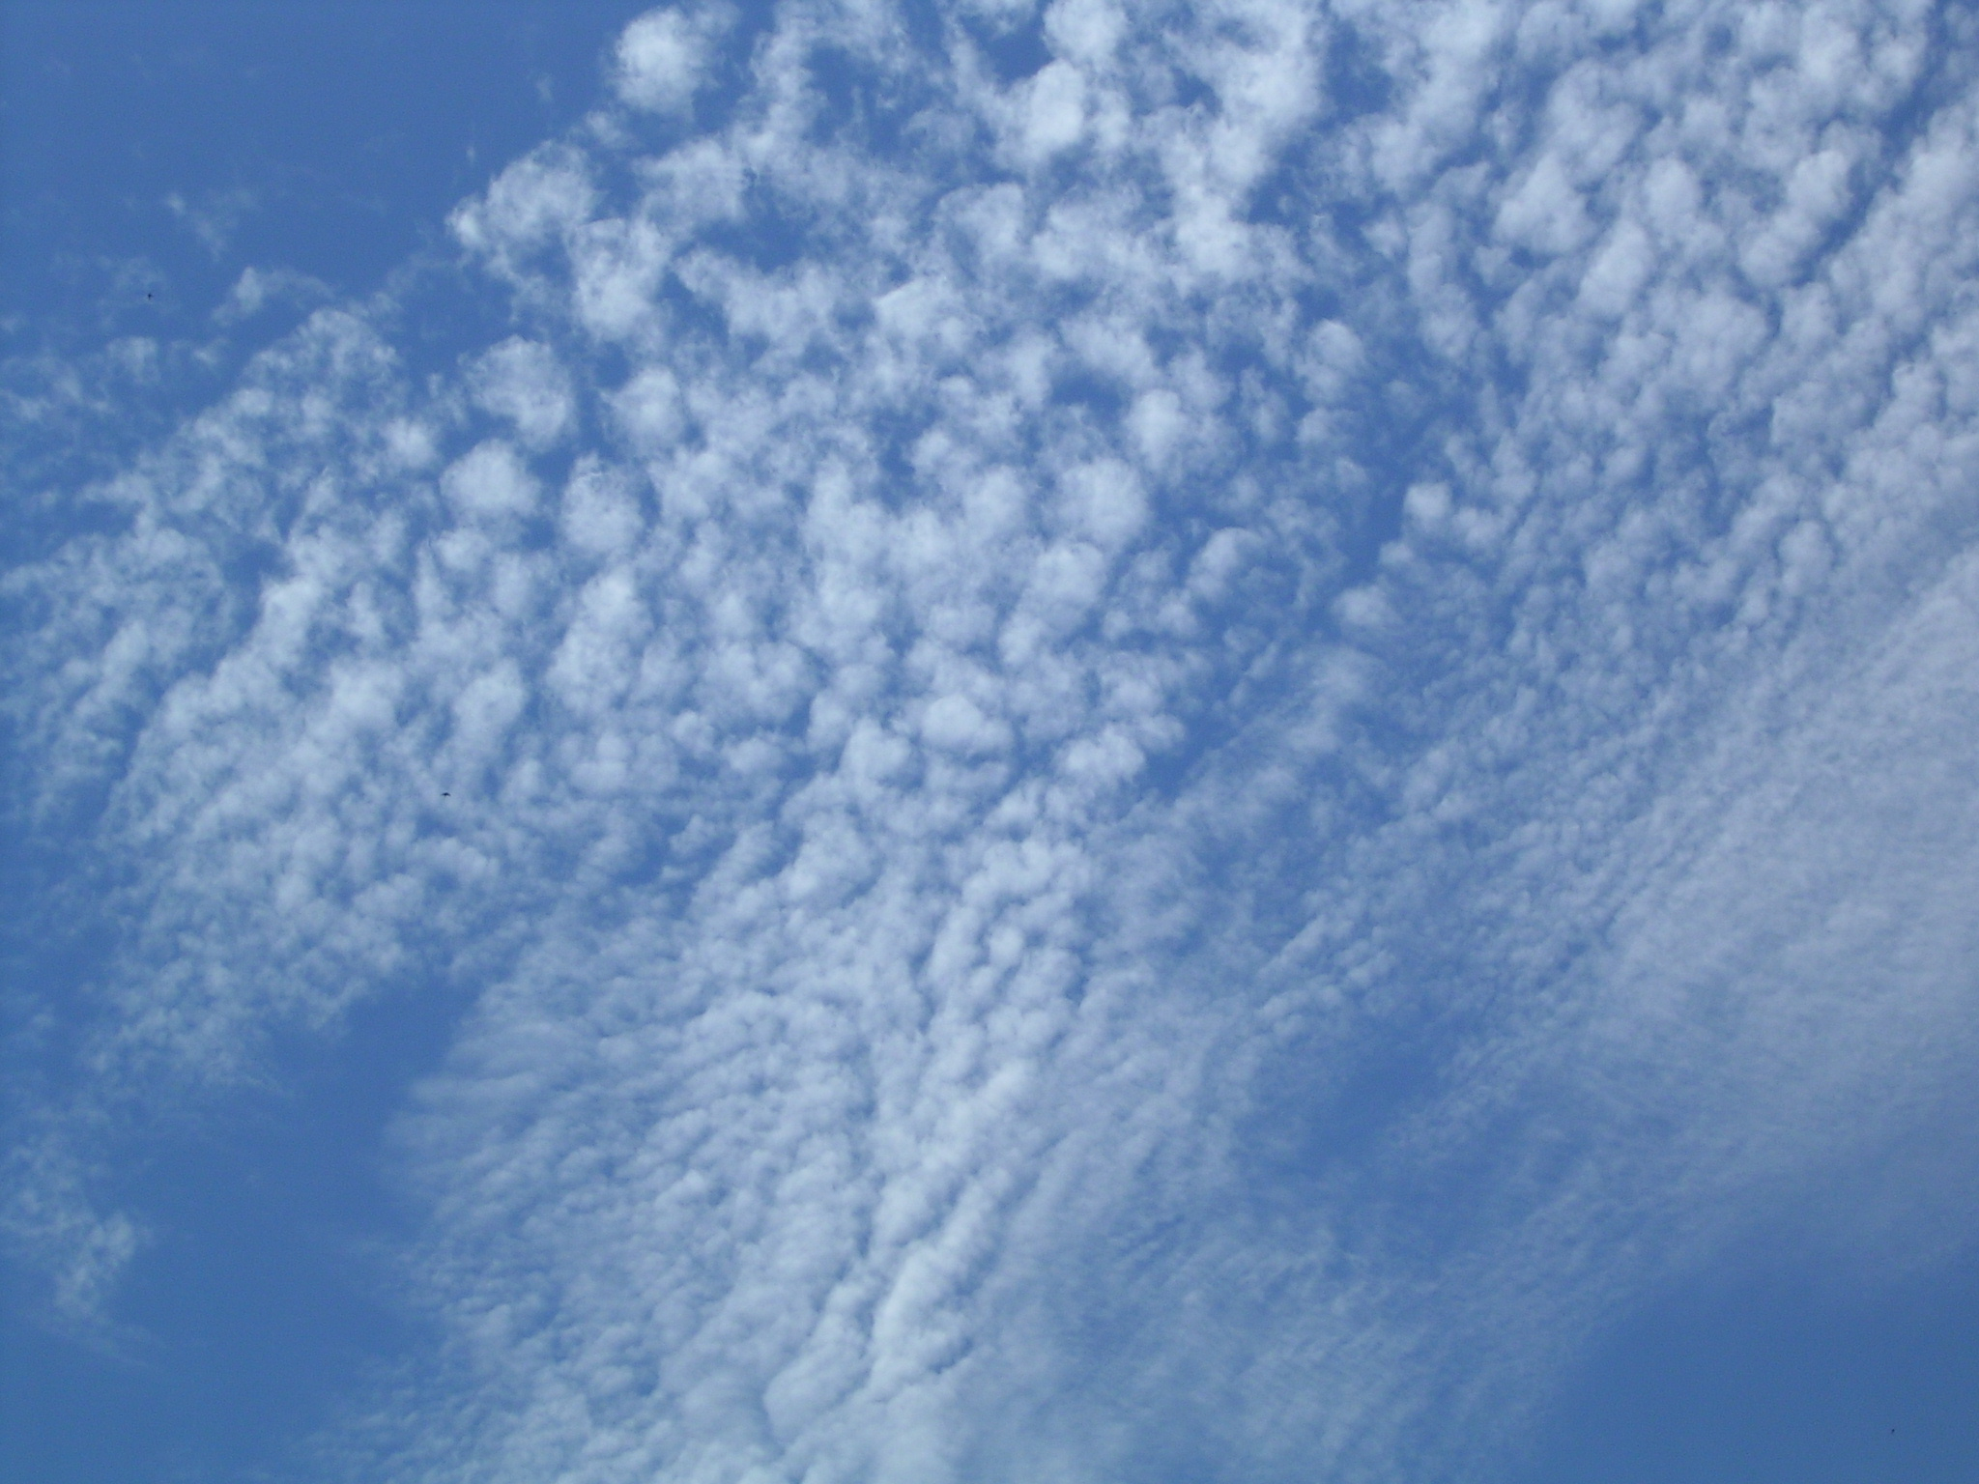
Notes:
Cirrocumulus

Slide 23
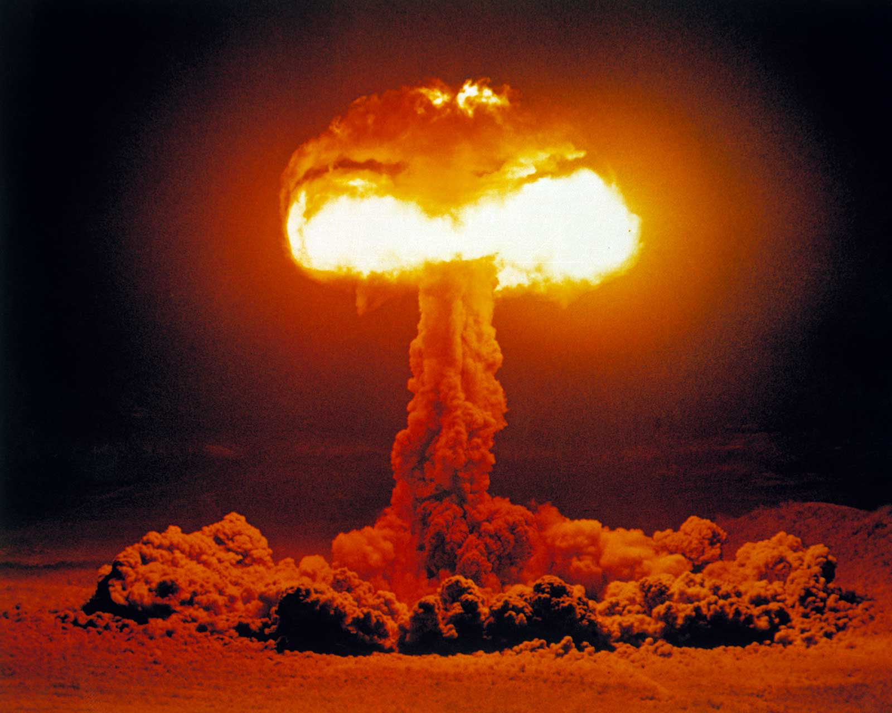
Notes:
Mushroom cloud

Slide 24

Notes:
Google cloud

Slide 25

Notes:
Rainbow Dash

Slide 26

Notes:
Cloud9

Slide 27
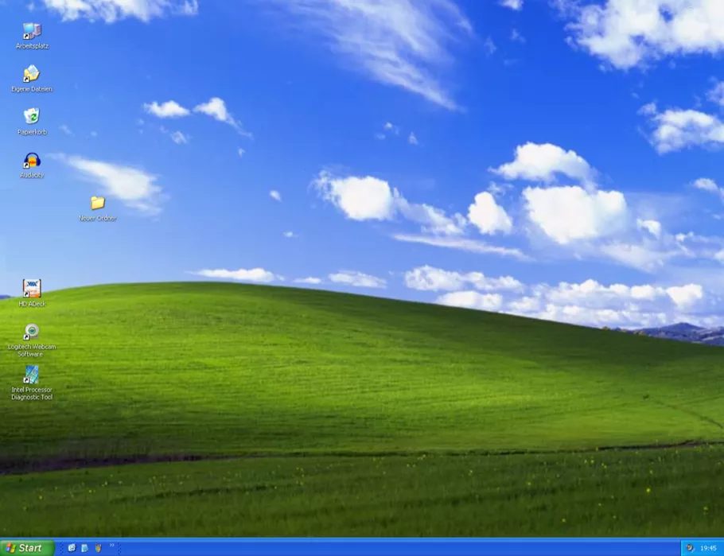
Notes:
Windows XP

Slide 28

Notes:
heaven

Slide 29
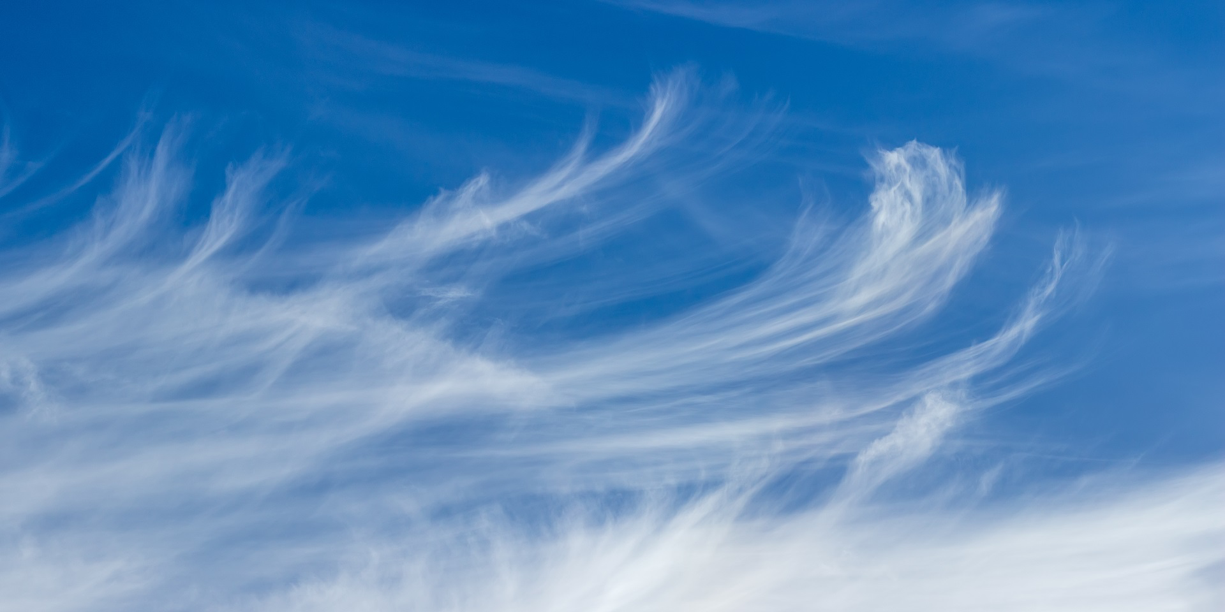
Notes:
cirrus

Slide 30

Notes:
Nimbus 2000

Slide 31

Notes:
Adventure Time/Cloud Kingdom

Slide 32

Notes:
Adobe Creative Cloud

Slide 33
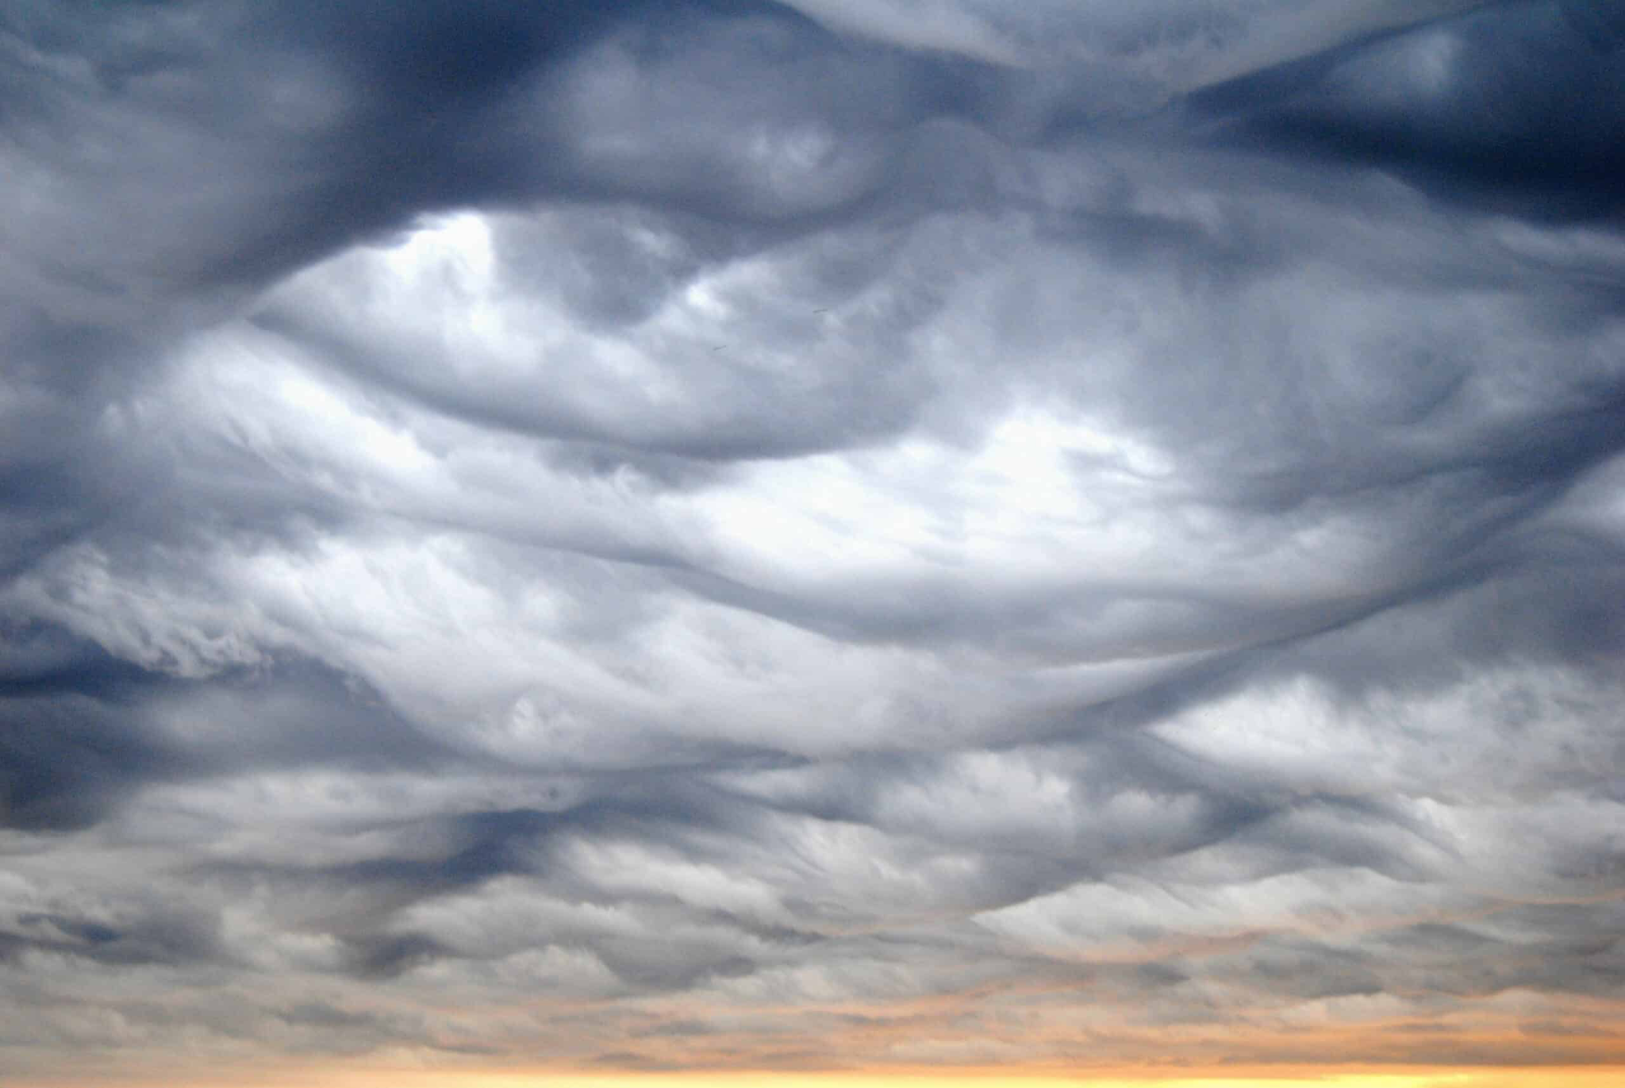
Notes:
Nimbostratus clouds

Slide 34

Notes:
Dreamworks

Slide 35
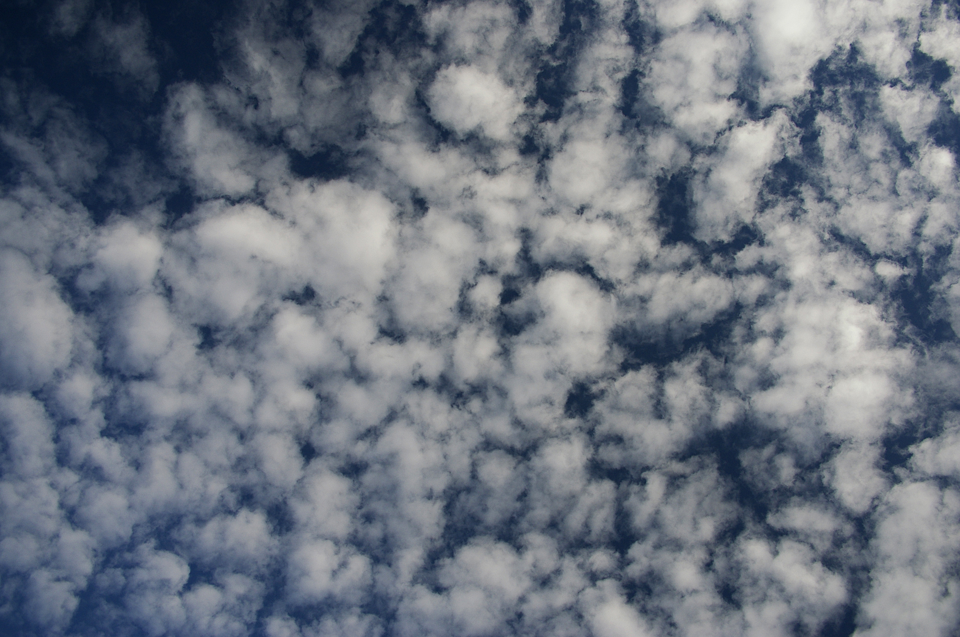
Notes:
Altocumulus clouds

Slide 36
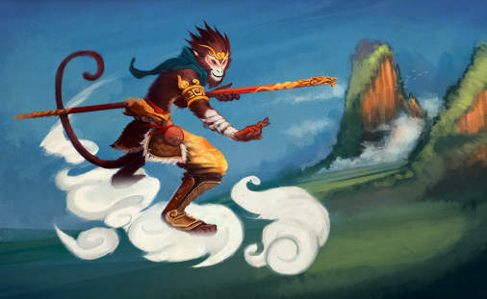
Notes:
Sun Wukong/Monkey King

Slide 37

Notes:
Microsoft OneDrive

Slide 38

Notes:
Castform

Slide 39

Notes:
Cloudy with a chance of meatballs

Slide 40
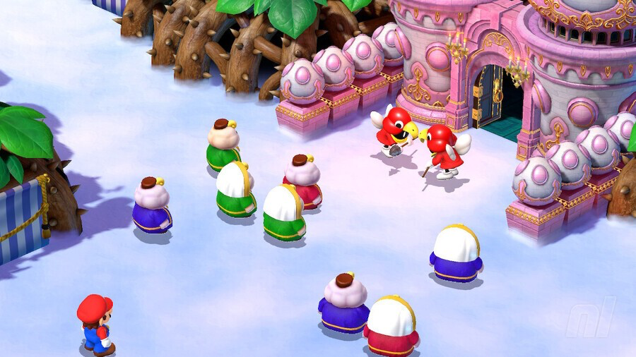
Notes:
Nimbus land

Slide 41
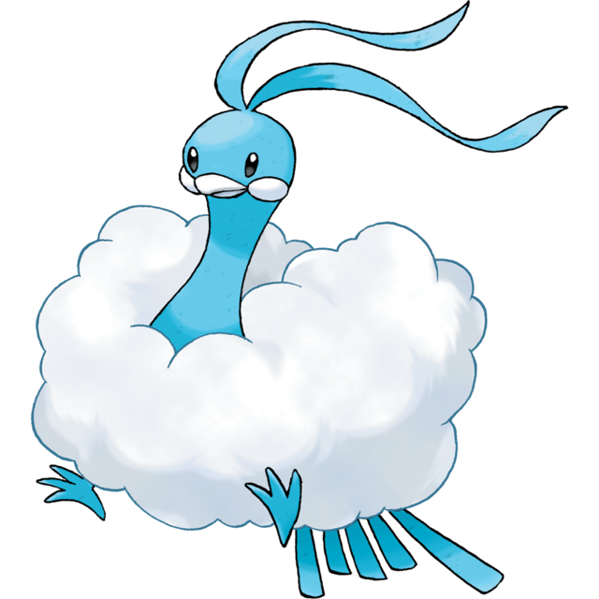
Notes:
Altaria

Slide 42
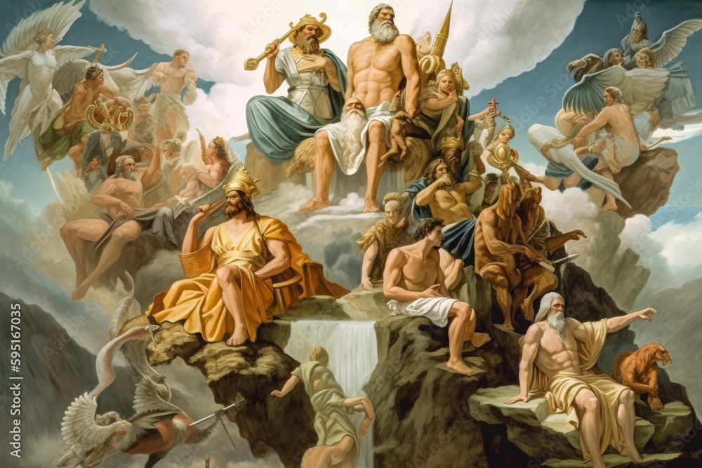
Notes:
Mount Olympus

Slide 43
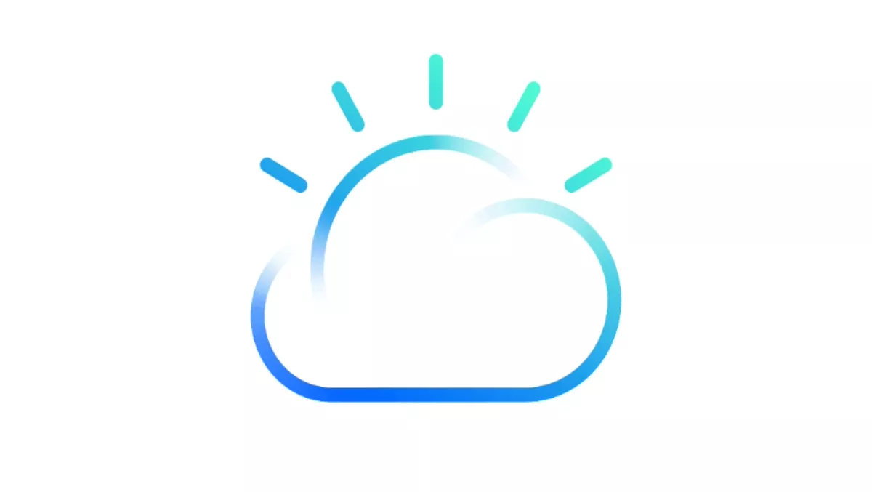
Notes:
IBM Cloud

Slide 44

Notes:
Rainbow road

Slide 45

Notes:
Castle in the sky

